Slide 1

SMART GESTURE CONTROL SWITCH SYSTEM USING IoT
Presented by :
Name : N. Jathin
Roll No. B22IN125
KITS Warangal

Slide 2

Objective of the Project :
To enable users to control electronic devices or systems through automatic hand gestures, which provide a convenient and hands-free interface for managing various functionalities.

Slide 3

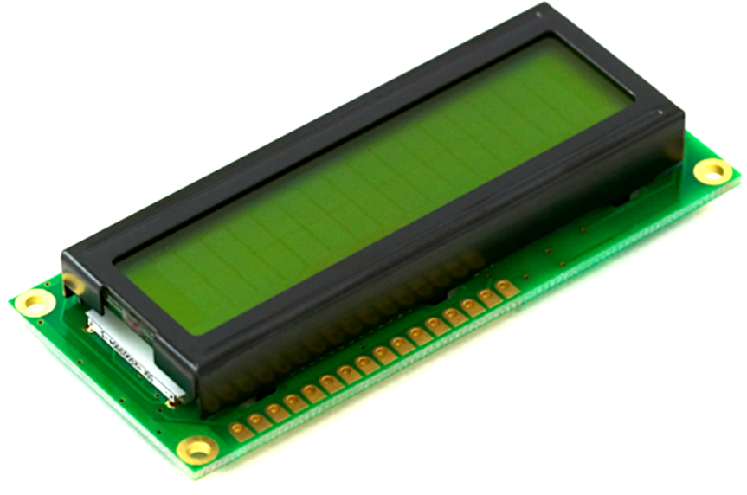
Methodology Software Requirements
Arduino IDE :
Download and install Arduino Integrated Development Environment (IDE).
APDS-9960 Library : #include <SparkFun_APDS9960.h>
Hardware Requirements
1.Arduino Board : Any Arduino board like Arduino Uno, Arduino Nano,etc.
2.16x2 LCD Display : A multifunction sensor that can detect gestures

Slide 4
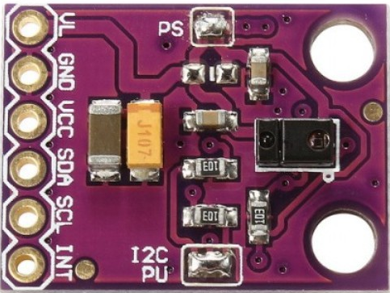
3. APDS-9960 Gesture Sensor :
The APDS-9960 is a digital RGB, ambient light, and proximity sensor with gesture detection capabilities.
It communicates via the I2C (Inter-Integrated Circuit) protocol
It's commonly used in various electronic devices for detecting hand gestures, ambient light intensity, color, and proximity.
The sensor can detect simple gestures (up, down, left, right) performed in front of it without physical contact.
This makes it suitable for applications where touchless interaction is desired.

Slide 5
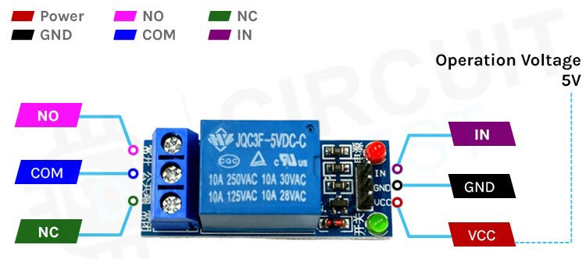
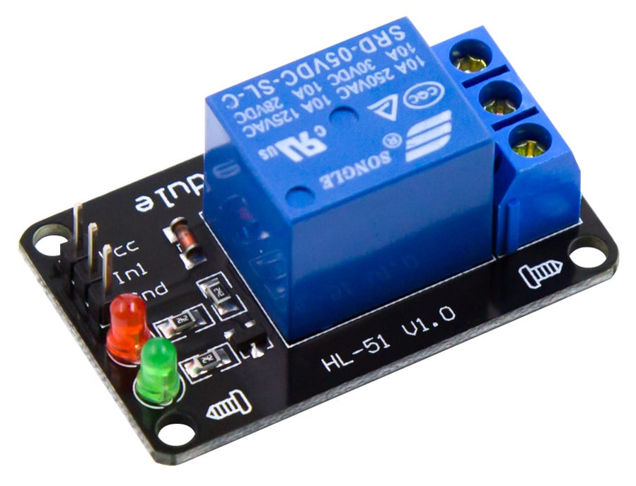
4. 5V Relay Module
The 5V relay module can be used to control a load such as a lighting system, motor, or solenoid.
It can also be used to switch AC or DC voltages.
Makes interfacing with a microcontroller or sensor easy with minimum components and connections.

Slide 6
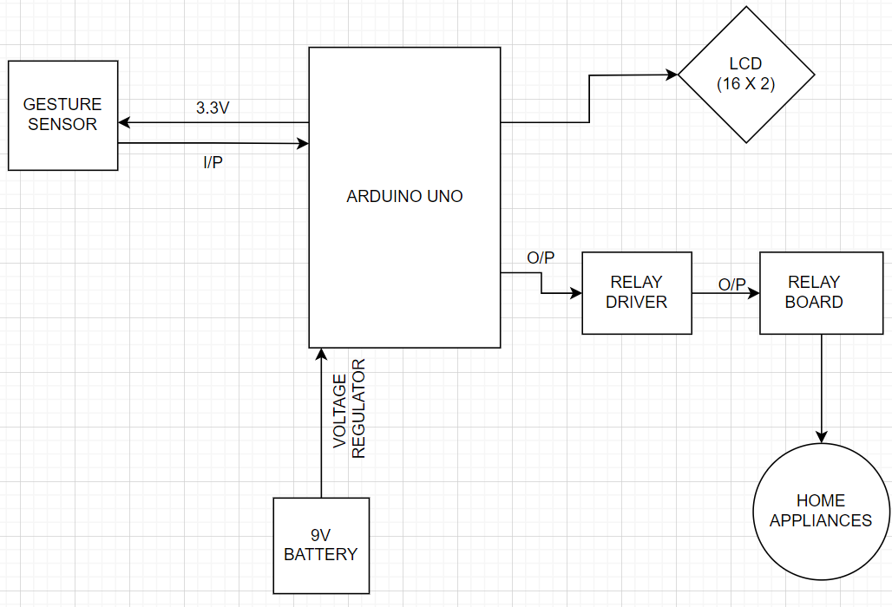
Block Diagram / Flow Chart :

Slide 7

Summary
The project is built on Arduino UNO and has an LCD module for the user interface, an APDS-9960 gesture sensor for user input, and a relay circuit to drive appliances ON or OFF, interfaced to it.
An open-source library for interfacing the APDS-9960 gesture sensor with the Arduino is utilized in the project. The Arduino code is written on the Arduino IDE and uploaded to the board using USB cable.
The relay circuit controlling the appliances is hard-wired with the Arduino-based remote control.
Once the circuit is powered, some initial messages are passed to the LCD module and the module starts displaying the horizontal list of appliances.

Slide 8

Result
Hence, the gesture sensor allows the proximity detection feature for the module to control all the appliances together.
If we move the finger in upward direction near the sensor module then all appliances are switched ON, and moving the finger downwards then the appliances are switched OFF.
If the finger is near the gesture module it will display “initializing gesture” on the LCD.
If the finger is far from the gesture module it will display “gesture timeout” on the LCD.

Slide 9

Conclusion
This proposed system is an IoT-based Gesture-Controlled Contactless Switch for a Smart Home to promote contactless communication using a microcontroller-circuit.Also cost-effective, practical, eco-friendly, and safest way to protect ourselves from contacting others.

Slide 10

References
Liu, T., Guo, H., and Wang, Y., "A new approach for color-based object recognition with the fusion of color models", Congress on Image and Signal Processing. Conference, Sanya-China, vol. 3, pp. 456-460, May 2008.
Deepak, B & Soubagya Nayak & Jalumuru Nalin, (2016), "Development of Gesture Controlled Robot Using 3-Axis Accelerometer", Journal of Control &Instrumentation. 7. 23-34.
ieee-sensors.org/myosa/rgb-and-gesture-sensor/sharvielectronics.com/product/apds9960-rgb-gesture-sensor-detect ion-i2c-breakout-module-for-arduino

